Slide 1

Food Trends: Understanding Customer Preferences in the F&B Industry
TEAM – B
Mahima Sharan
Gunjan Soni
Iti Tiwari
Lekshmi R
Pooja Kumari
Meher Raju
Nithiksha N

Slide 2
Introduction
The food and beverage industry is rapidly evolving due to technological integration and changing consumer lifestyles. Understanding customer choices and ordering behaviour has become crucial for business sustainability. This analysis explores how data visualization can uncover these insights.
The F&B industry is evolving rapidly with digitalization and changing lifestyles.
Online food delivery has transformed customer interactions and preferences.
Businesses rely on data analytics to identify demand, sales, and satisfaction trends.
This study explores how data can uncover key insights for growth in the F&B sector.

Slide 3
Why This Dashboard
To analyse customer behaviour and spending patterns in one place.
Identify popular cuisines and eating habits.
Track online ordering trends and favourite food delivery apps.
Understand demographics : age, gender, income, and occupation.
Measure marketing performance across platforms.
Study sustainability awareness and organic food preference.
Support data-driven business and marketing decisions.

Slide 4
Industry Context – Global & Indian Food Trends
The food industry is shifting due to changing consumer behaviour:
Preference for healthy, natural, and plant-based options.
Rise of veganism and flexitarian diets.
Increasing demand for convenience + nutrition (ready-to-eat, meal kits).
In India:
Growing urban youth population experimenting with diets.
Higher awareness of lifestyle diseases
Traditional food habits blending with modern health choices.
.

Slide 5
Problem Statement
Businesses often struggle to align products and services with dynamic consumer expectations. Identifying which factors influence demand like time, region, or category remains a challenge. The study addresses these gaps through comprehensive data-driven exploration.
Businesses struggle to understand diverse customer preferences.
Lack of clarity on seasonal, regional, and platform-based demand.
Difficulty in forecasting sales and aligning offerings to customer needs.
The project addresses these issues through data visualization and analytics.

Slide 6
Objectives
The study aims to extract meaningful insights from food sales data and improve decision-making in the F&B sector. Each objective focuses on enhancing the understanding of consumer behaviour through data patterns and key performance indicators.
Analyse customer demographics and purchasing preferences.
Identify high-performing categories and underperforming regions.
Study seasonal and time-based demand patterns.
Evaluate performance across food delivery platforms.
Derive data-driven business recommendations for improvement.

Slide 7
Scope of the Study
The scope emphasizes the breadth of analysis within the dataset, covering multiple demographic, regional, and behavioural factors. It also focuses on comparing performance between food delivery platforms and understanding consumer satisfaction.
Focuses on customer data across multiple Indian regions and cities.
Includes sales, category performance, payment methods, and ratings.
Considers both delivery platforms: Swiggy and Zomato.
Timeframe covers monthly and seasonal analysis for a complete overview.

Slide 8
Dataset Description
The dataset provides comprehensive information about customer orders and preferences. With multiple attributes, it enables detailed analysis of buying patterns, satisfaction, and operational metrics across varied demographics.
Total Records: ~14000 rows | 20 Attributes
Key Columns:
Customer ID, Age, Gender, Location, Food Category
Platform, Order Value, Rating, Payment Mode
Delivery Time, Season, Feedback Score, Frequency of Orders
Cleaned and processed for consistent, insightful analysis

Slide 9
Tools and Technology Used
This project leverages advanced analytical and visualization tools to convert raw data into actionable insights. Power BI serves as the core platform for transforming datasets into interactive dashboards.
Power BI – dashboard creation and visualization
Excel – data cleaning and organization
DAX – for KPIs and custom calculations
Power Query – for data transformation
Forecasting Tool (Power BI) – for predictive trends

Slide 10
Methodology Overview
The methodology outlines the step-by-step approach from data collection to visualization. It emphasizes systematic data cleaning, transformation, and dashboard development to ensure accuracy and relevance in insights.
Data collection and cleaning in Excel.
Transformation using Power Query in Power BI.
Dashboard design with KPIs and visuals.
DAX used for calculated measures.
Insights extracted, validated, and reviewed.
Reporting and presentation compiled for submission.

Slide 11
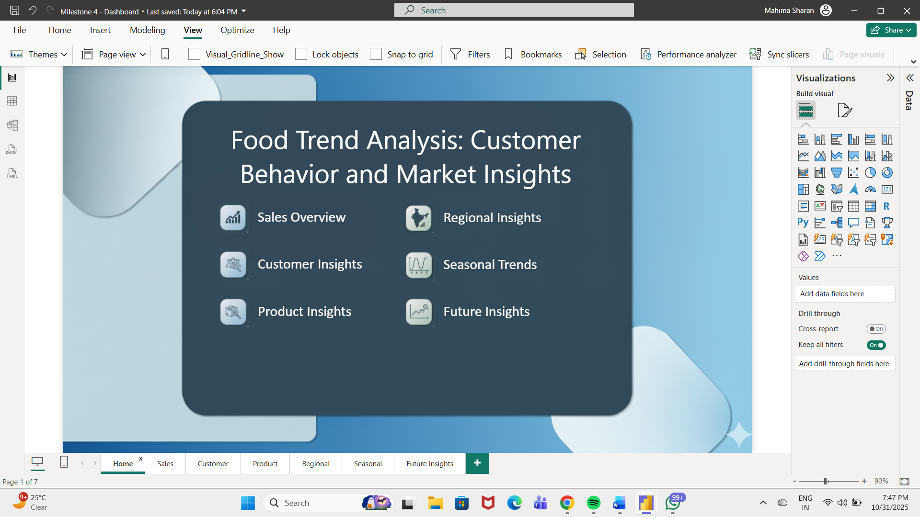
Dashboard Overview
The home page provides a unified summary of key business metrics and serves as the entry point for detailed analysis. It visually represents overall sales, customer base, and ratings at a glance.

Slide 12
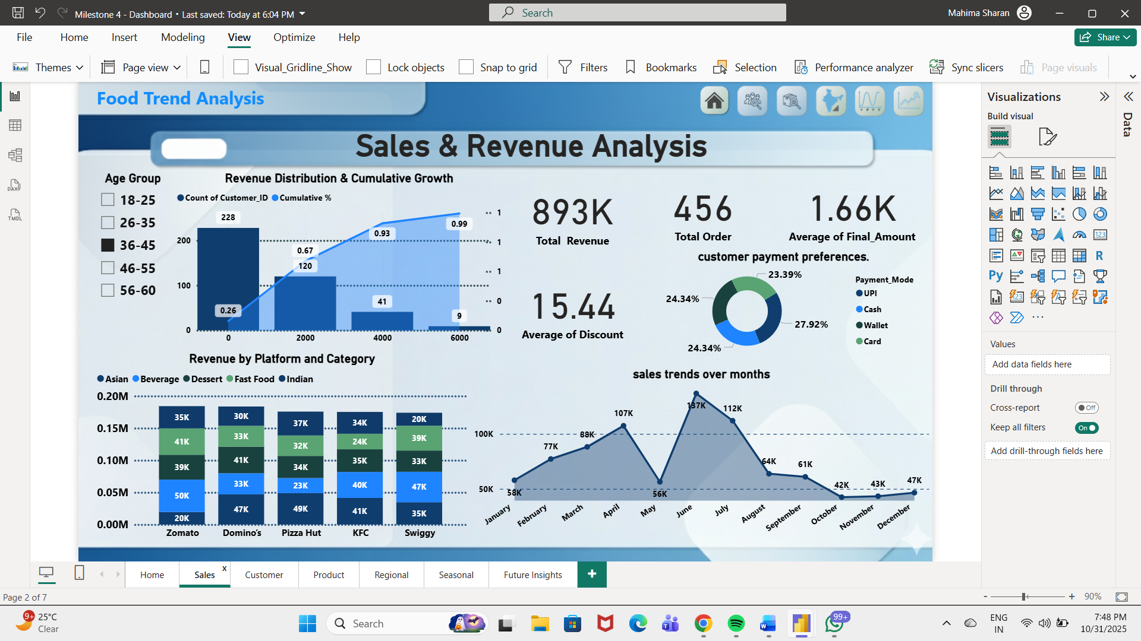
Sales & Performance Insights
Sales metrics form the backbone of business intelligence. By analysing sales trends, order frequency, and payment modes, businesses can identify their strongest performance areas and weaknesses.

Slide 13
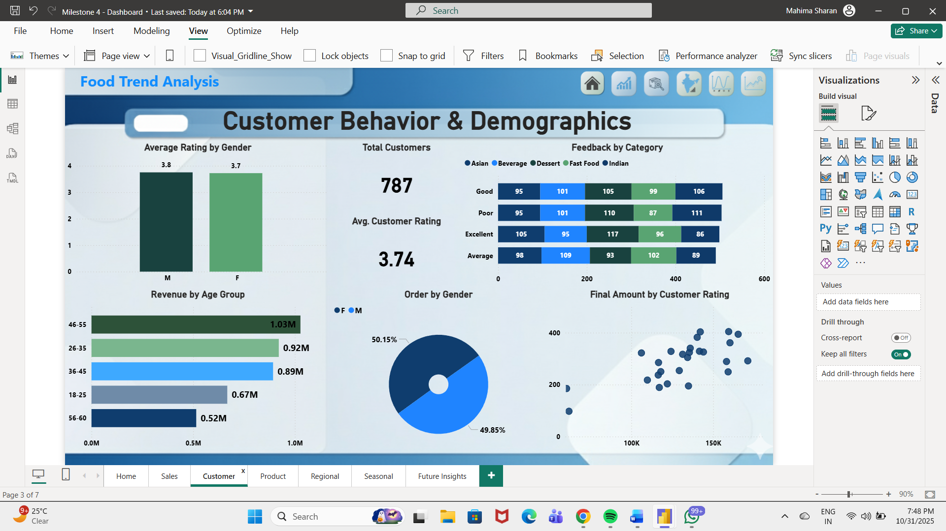
Customer Demographics & Preferences
Demographic insights reveal which customer segments drive the highest engagement and sales. Understanding these segments helps tailor products and marketing strategies effectively.

Slide 14
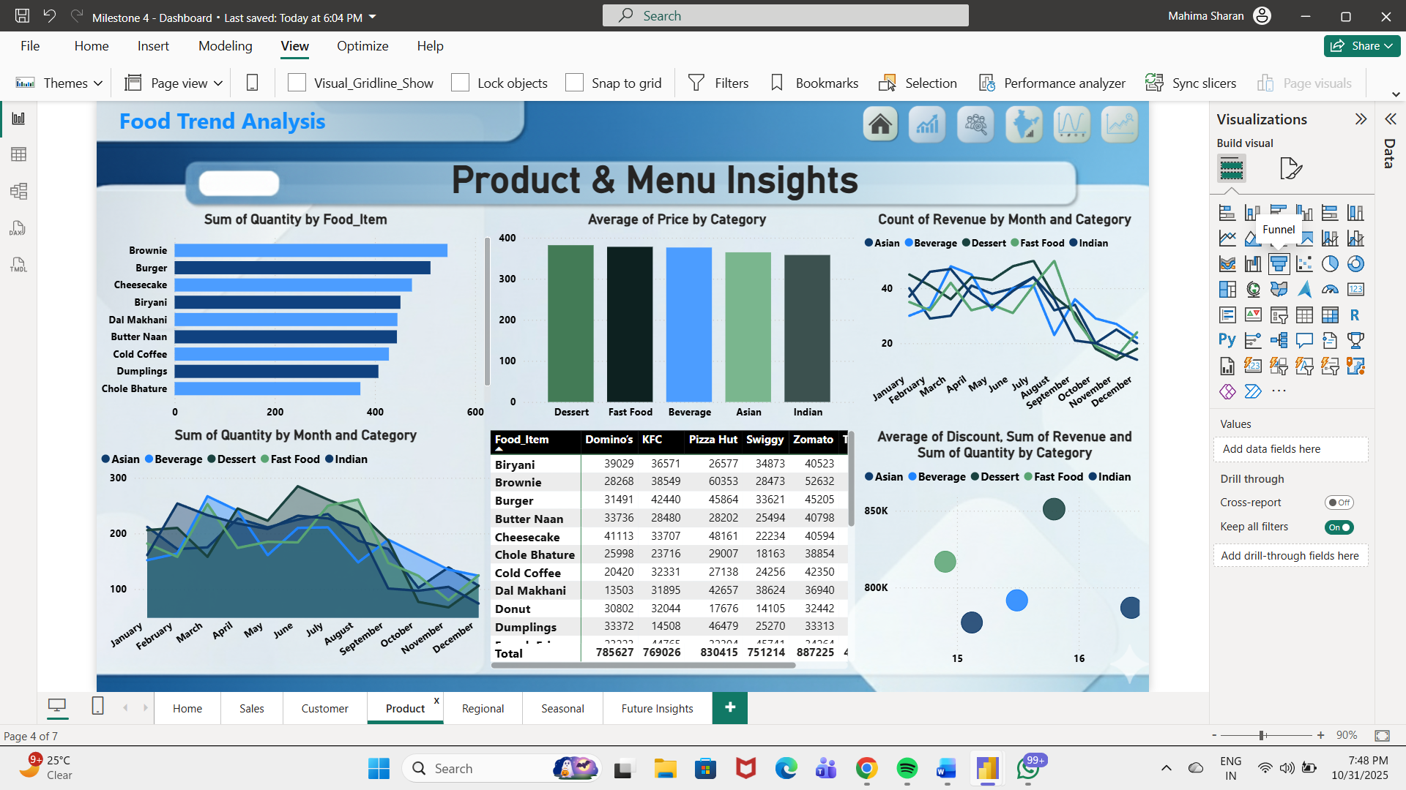
Product Category Analysis
Product category analysis highlights which food types contribute most to revenue and satisfaction. It aids in optimizing inventory and marketing strategies based on popularity and profitability.

Slide 15
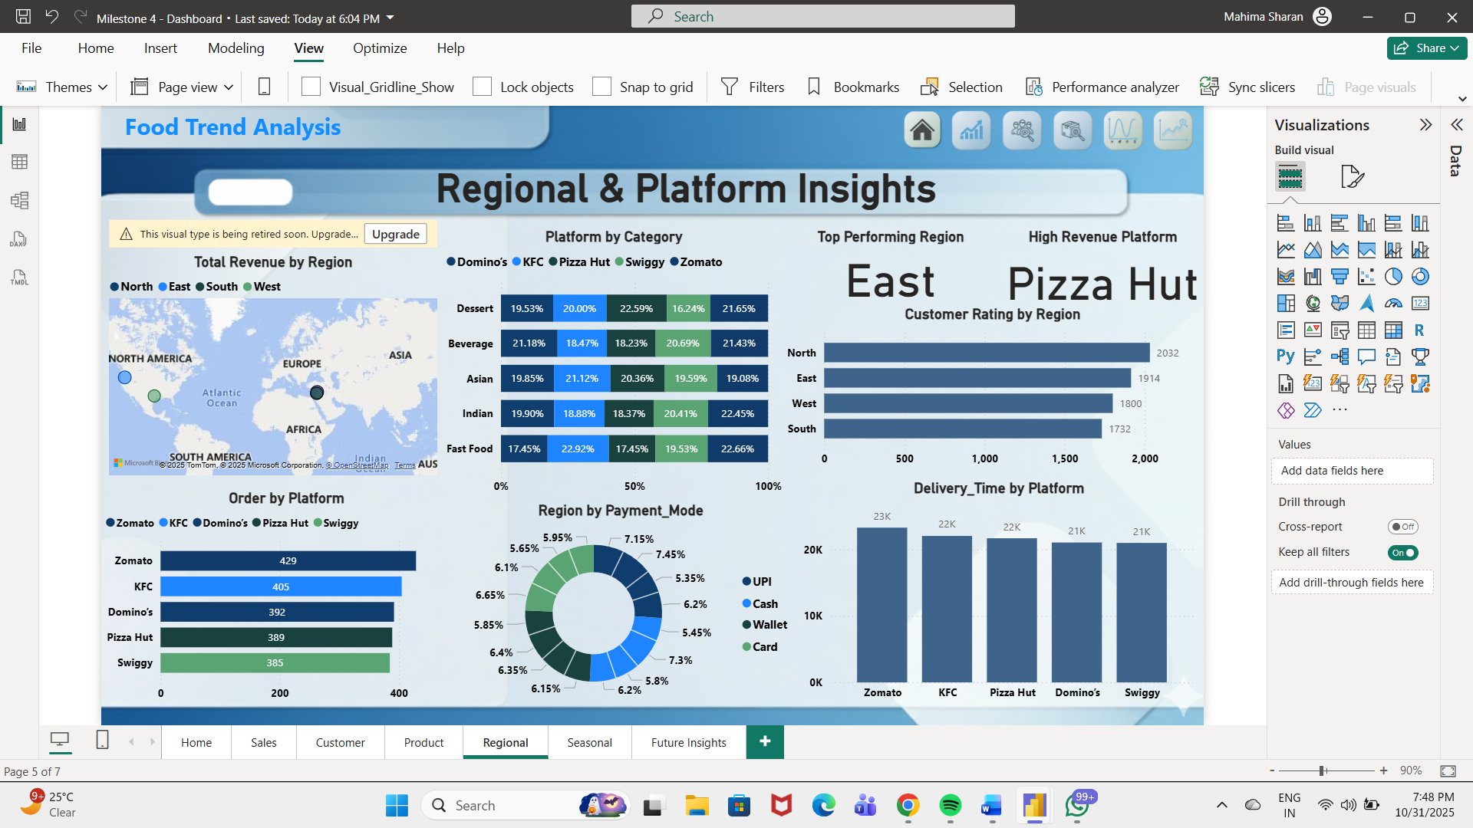
Regional & Platform Insights
Regional and platform analysis brings clarity to performance across locations and delivery services. It identifies revenue leaders and helps allocate marketing resources effectively.

Slide 16
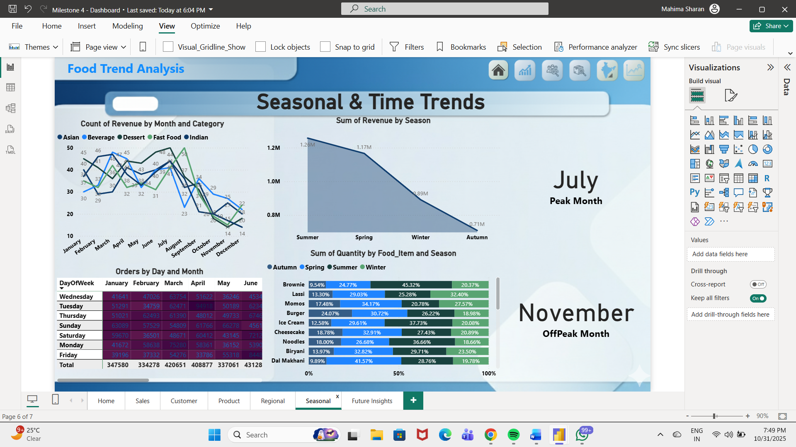
Seasonal & Time-Based Trends
Time-based analysis uncovers when and what customers prefer to order. Recognizing these peaks enables better promotions, staffing, and logistics planning.

Slide 17
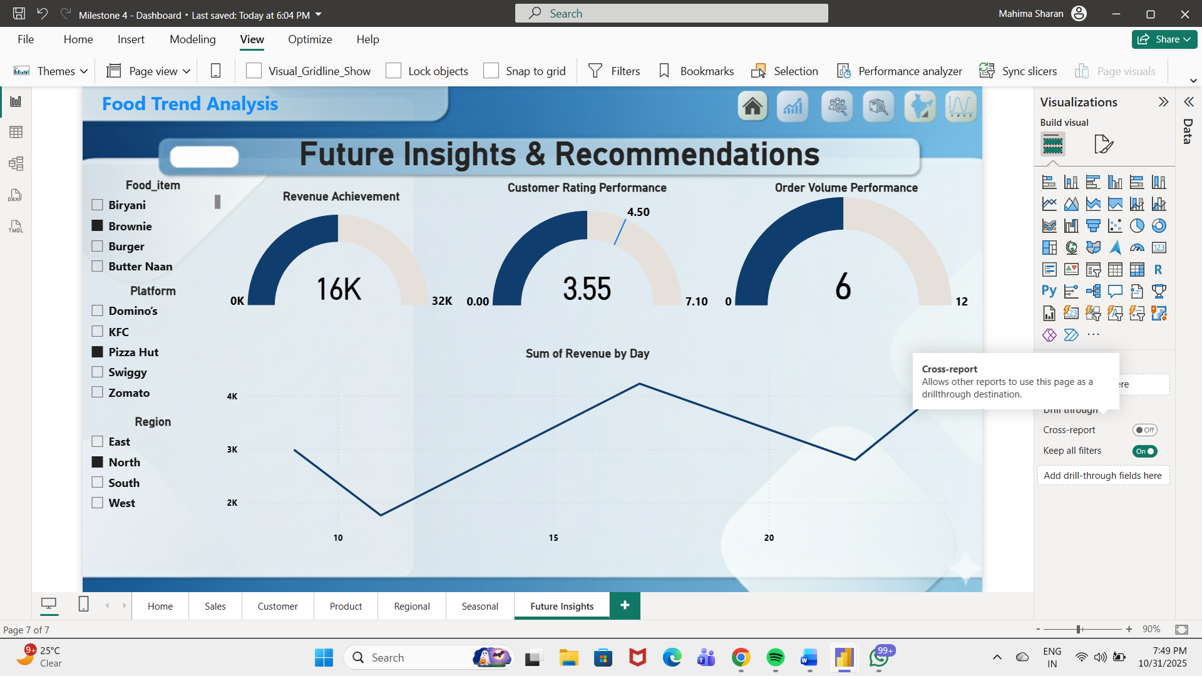
Future Insights & Recommendations
Future analysis projects customer demand using predictive models. These insights guide strategies to sustain business growth and profitability in the upcoming quarters.

Slide 18
Business Impact
Applying data-driven insights enhances performance and strategic clarity. The outcomes of this project can directly influence sales, customer satisfaction, and market competitiveness.
Improved decision-making through real-time data insights.
Better understanding of customer demographics and needs.
Enhanced operational efficiency and profitability.
Stronger competitive advantage in the F&B market.

Slide 19
Learnings & Skills Gained
The project fostered both technical and interpersonal skill development. It provided practical exposure to real-world data visualization and analytical reasoning.
Power BI proficiency and dashboarding expertise
Hands-on experience with Power Query and DAX.
Strengthened analytical and visualization abilities.
Improved teamwork, coordination, and problem-solving skills.
.

Slide 20
Conclusion
The study successfully analysed food trends and customer preferences within the F&B industry through data-driven insights. Using Power BI, the project visualized key metrics like sales, demographics, and platform performance, providing a comprehensive view of consumer behaviour and business performance.
Fast Food and Beverages emerged as top-performing categories.
Regional and seasonal patterns significantly affect order trends.
Power BI enabled clear and actionable business insights.
Insights improve marketing, inventory, and pricing strategies.
Data-driven decisions enhance profitability and efficiency.
The project establishes a framework for sustained growth and better customer engagement.

